Slide 1

CREDIT EDA CASE STUDY
Roopali Mishra and Abhay Saxena

Slide 2
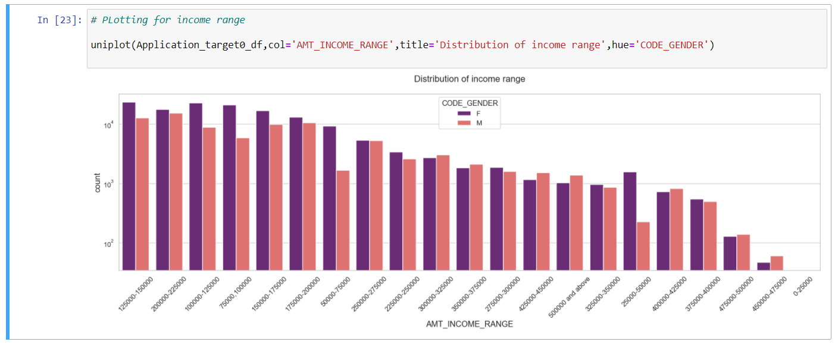
Distribution of Income range
Points to be concluded from the graph on the right side.
1. Female counts are higher than male.
2. Income range from 100000 to 200000 is having more number of credits.
3. This graph show that females are more than male in having credits for that range.
4. Very less count for income range 400000 and above.

Slide 3
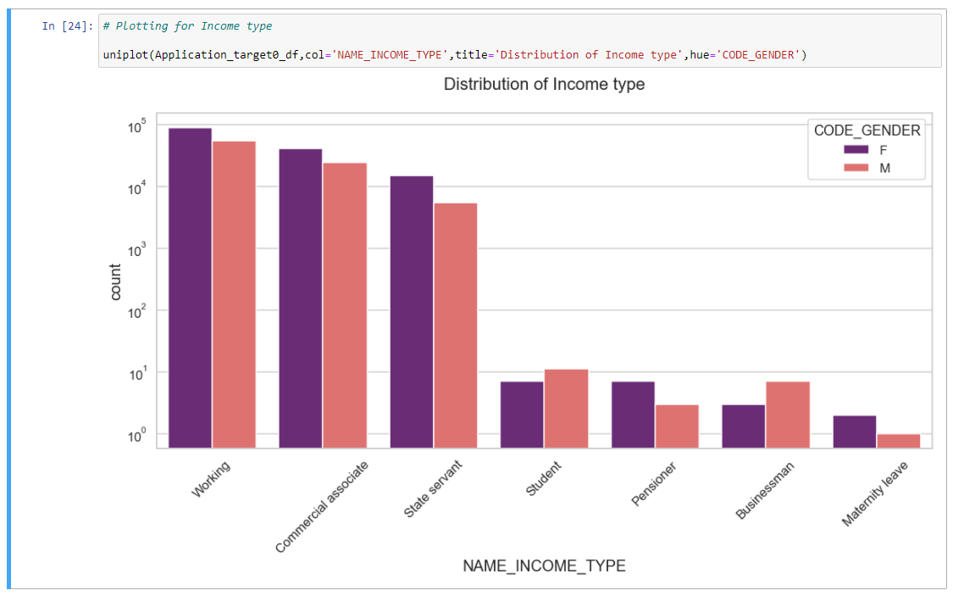
Distribution of Income Type
Points to be concluded from the graph on the right.1.
1. For income type ‘working’, ’commercial associate’, and ‘State Servant’ the number of credits are higher than others.
2. For this Females are having more number of credits than male.
3. Less number of credits for income type ‘student’ ,’pensioner’, ‘Businessman’ and ‘Maternity leave’.

Slide 4
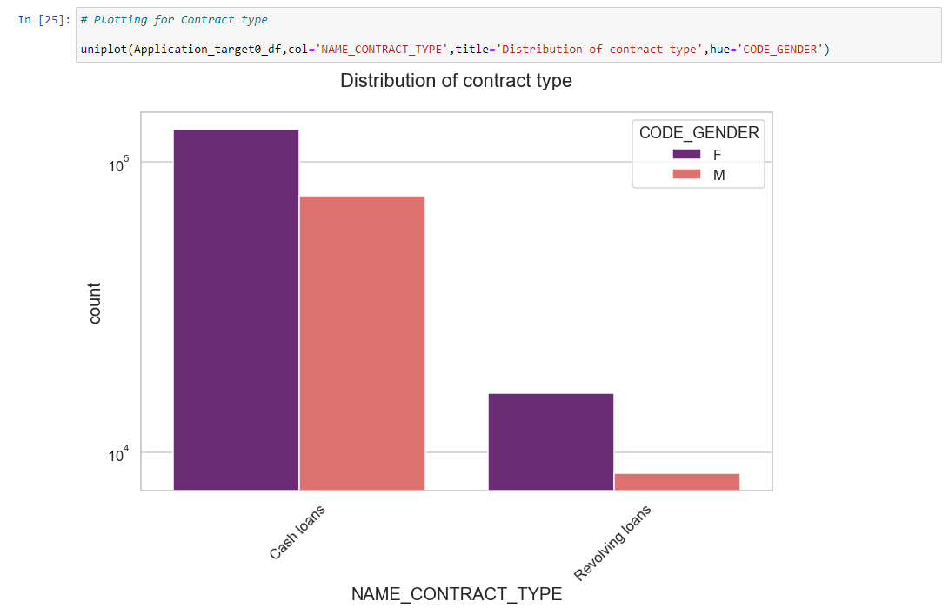
Distribution for contract type
Points to be concluded from the graph on the right.
1. For contract type ‘cash loans’ is having higher number of credits than ‘Revolving loans’ contract type.
2. For this also Female is leading for applying credits.

Slide 5
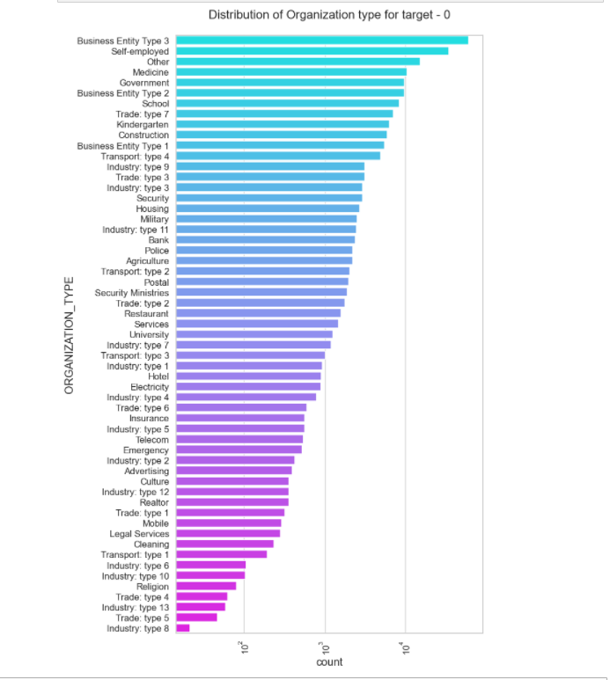
Distribution of organization type
Points to be concluded from the graph on the right.
1. Clients which have applied for credits are from most of the organization type ‘Business entity Type 3’ , ‘Self employed’ , ‘Other’ , ‘Medicine’ and ‘Government’.
2. Less clients are from Industry type 8,type 6, type 10, religion and trade type 5, type 4.

Slide 6
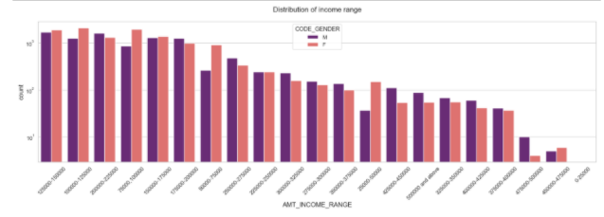
Points to be concluded from the above graph.
1. Male counts are higher than female.
2. Income range from 100000 to 200000 is having more number of credits.
3. This graph show that males are more than female in having credits for that range.
4. Very less count for income range 400000 and above.

Slide 7
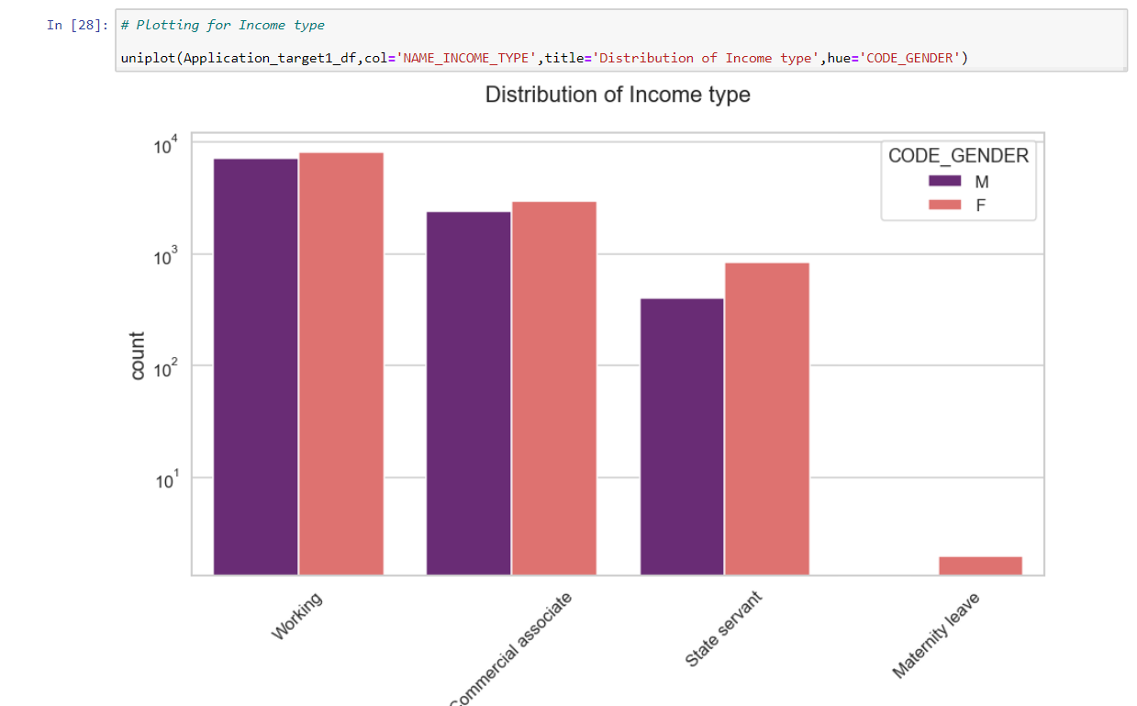
Points to be concluded from the above graph.
1. For income type ‘working’, ’commercial associate’, and ‘State Servant’ the number of credits are higher than other i.e. ‘Maternity leave.
2. For this Females are having more number of credits than male.
3. Less number of credits for income type ‘Maternity leave’.
4. For type 1: There is no income type for ‘student’ , ’pensioner’ and ‘Businessman’ which means they don’t do any late payments.

Slide 8
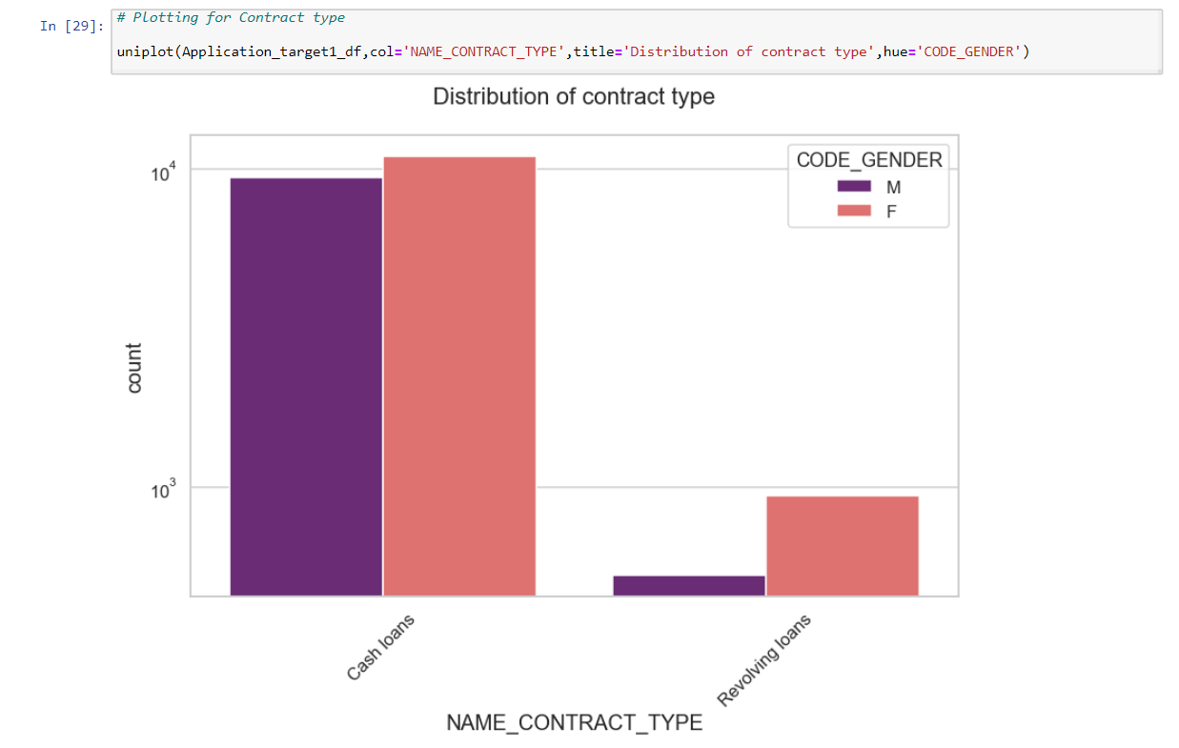
Points to be concluded from the above graph.
1. For contract type ‘cash loans’ is having higher number of credits than ‘Revolving loans’ contract type.
2. For this also Female is leading for applying credits.
3. For type 1 : there is only Female Revolving loans.

Slide 9
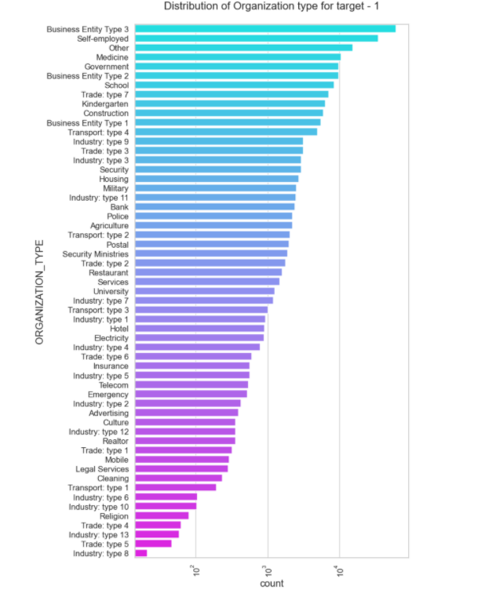
Points to be concluded from the above graph.
1. Clients which have applied for credits are from most of the organization type ‘Business entity Type 3’ , ‘Self employed’ , ‘Other’ , ‘Medicine’ and ‘Government’.¶
2. Less clients are from Industry type 8,type 6, type 10, religion and trade type 5, type 4.
3. Same as type 0 in distribution of organization type.

Slide 10
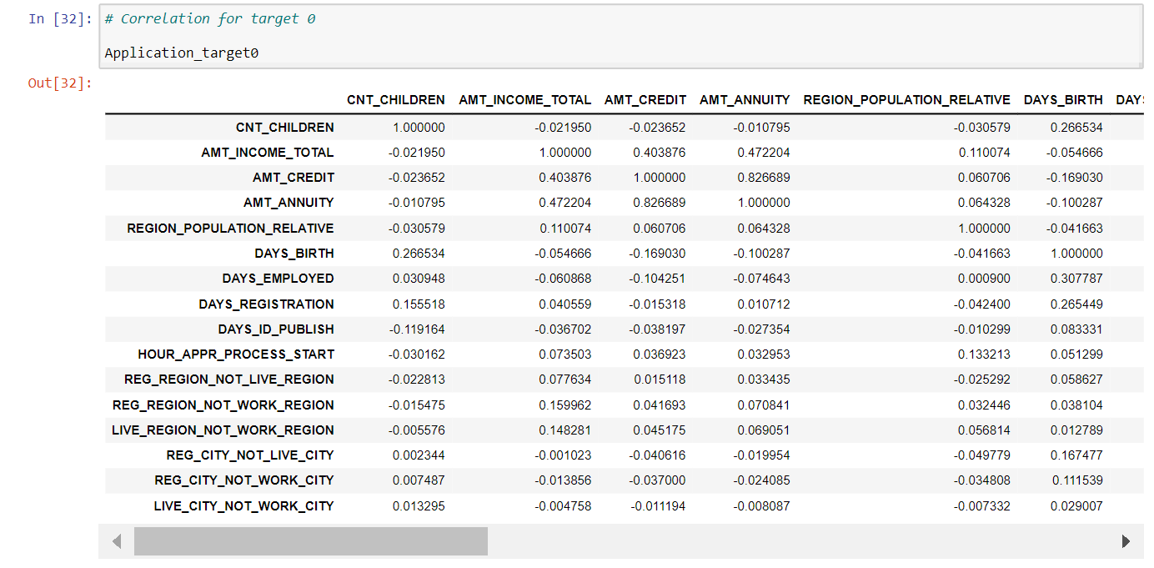

Slide 11
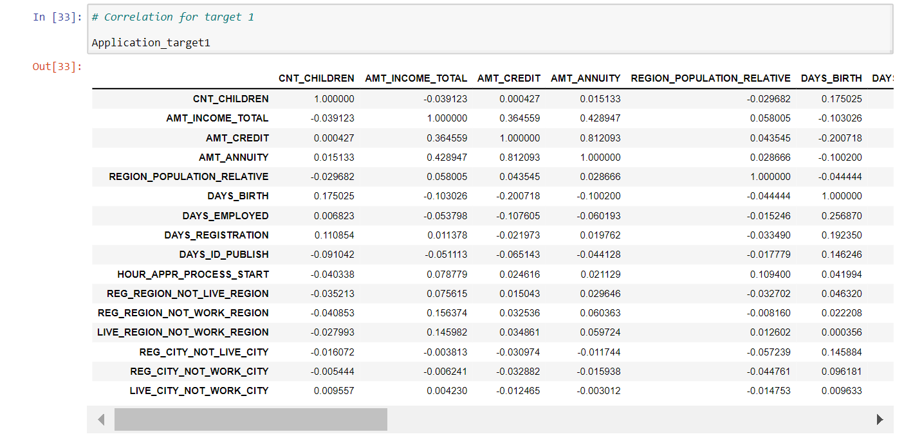

Slide 12
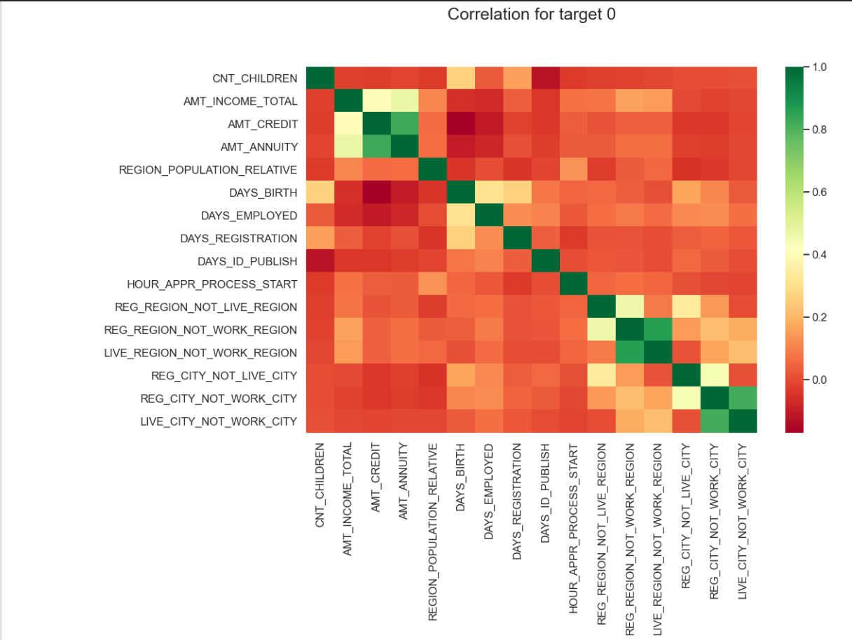

Slide 13
As we can see from above correlation heatmap, There are number of observation we can point out
1. Credit amount is inversely proportional to the date of birth, which means Credit amount is higher for low age and vice-versa.
2. Credit amount is inversely proportional to the number of children client have, means Credit amount is higher for less children count client have and vice-versa.
3. Income amount is inversely proportional to the number of children client have, means more income for less children client have and vice-versa.
4. less children client have in densely populated area.
5. Credit amount is higher to densely populated area.
6. The income is also higher in densely populated area.

Slide 14
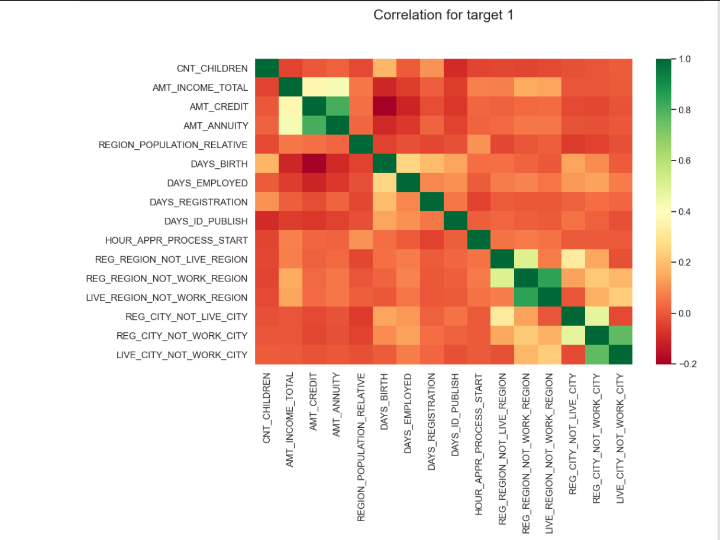
This heat map for Target 1 is also having quite a same observation just like Target 0. But for few points are different. They are listed below.
1. The client's permanent address does not match contact address are having less children and vice-versa
2. the client's permanent address does not match work address are having less children and vice-versa
Univariate analysis for variables

Slide 15
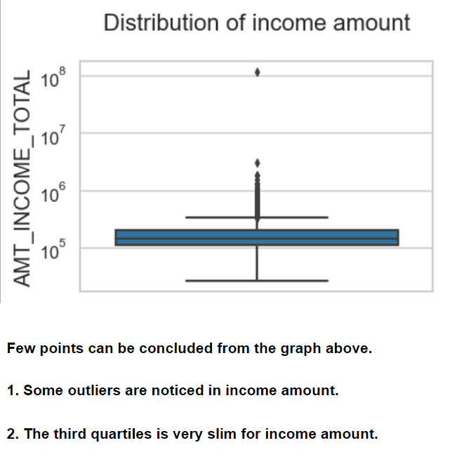

Slide 16
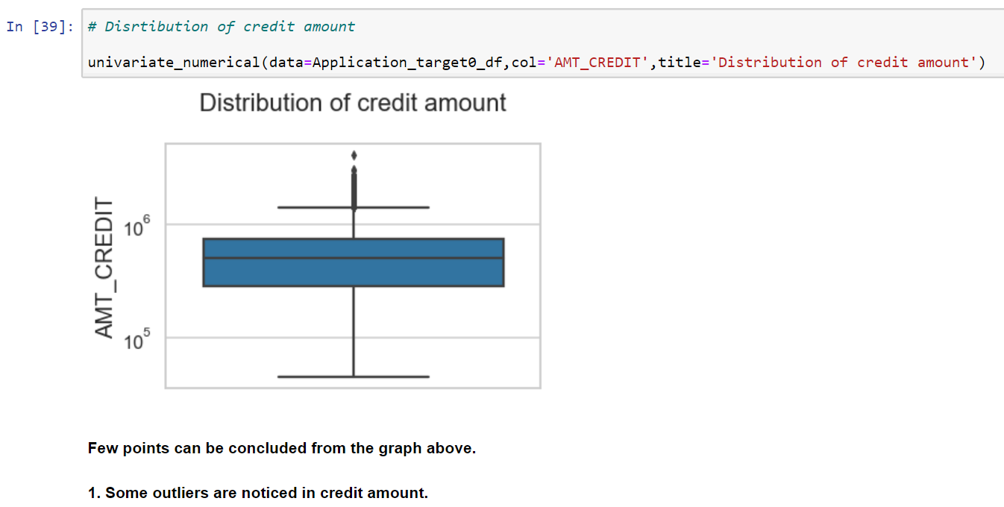

Slide 17
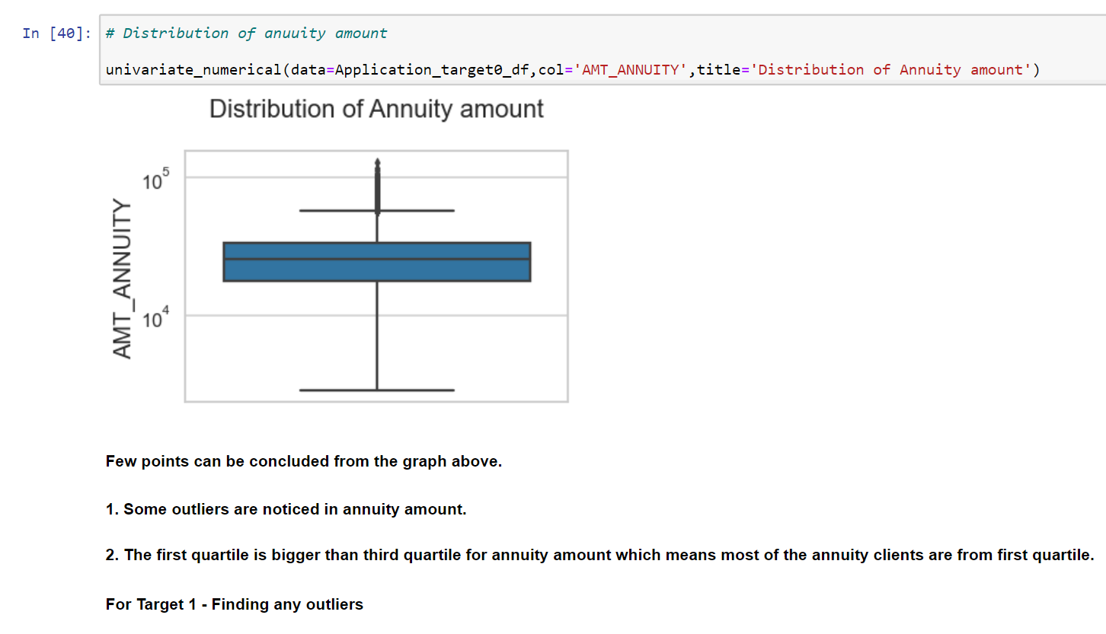

Slide 18
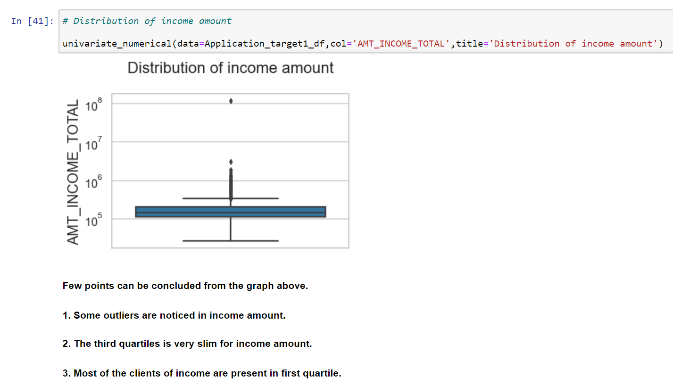

Slide 19
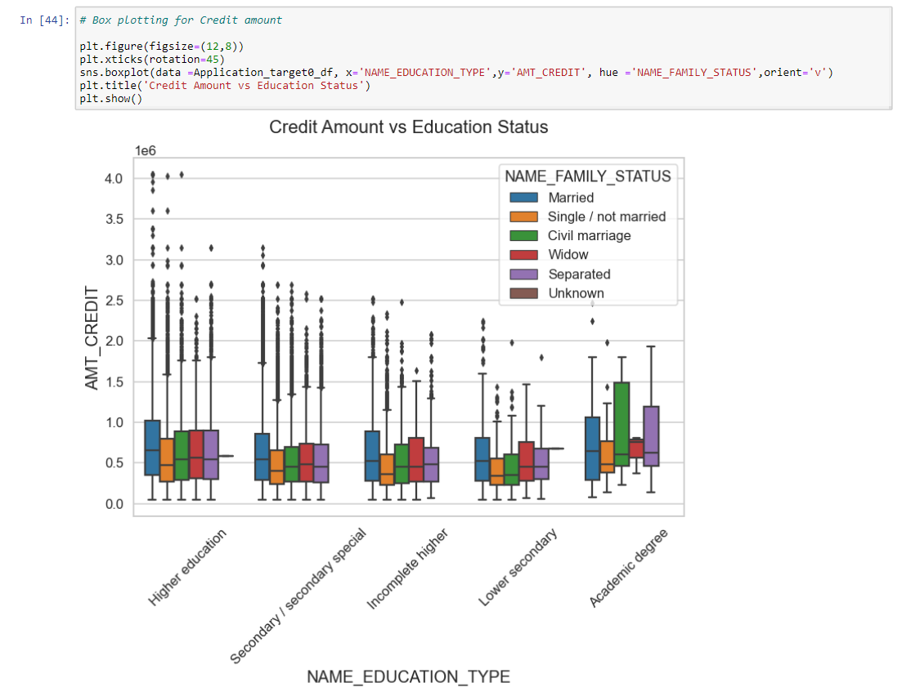

Slide 20
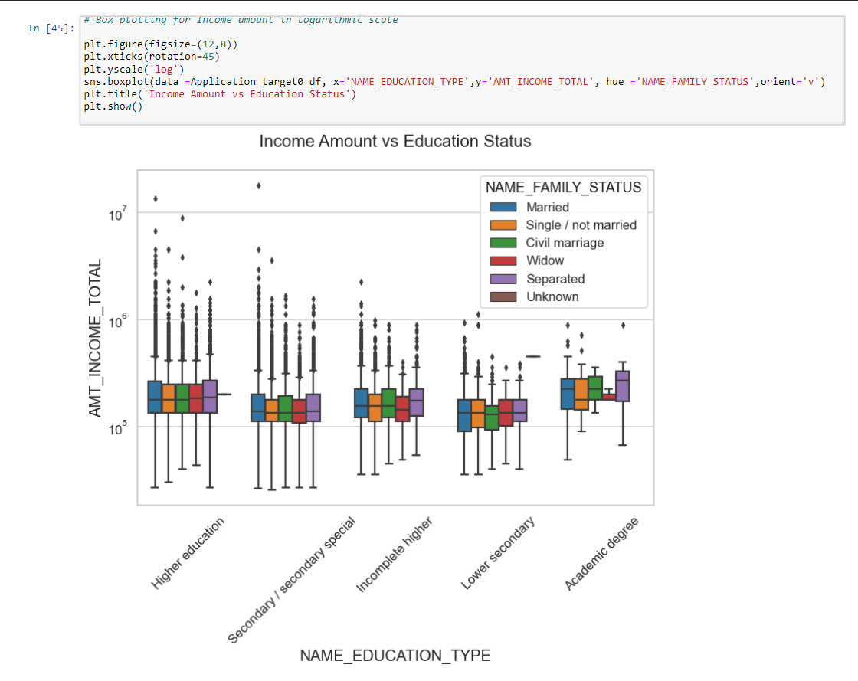

Slide 21
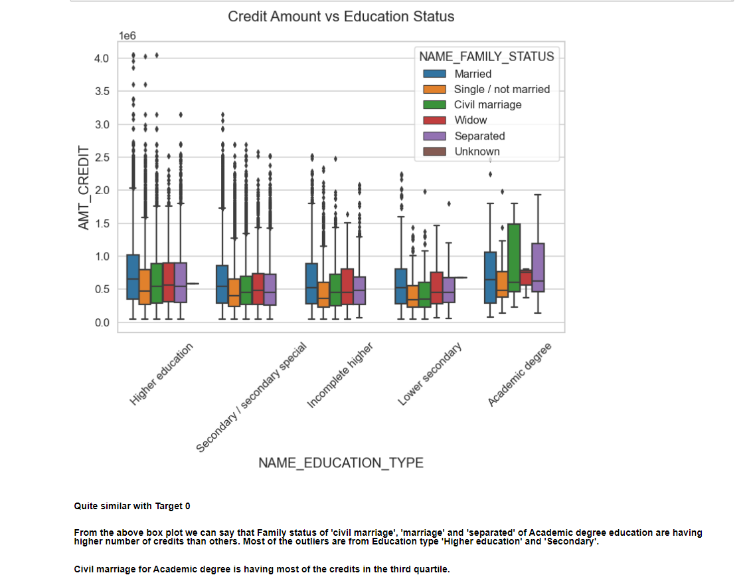

Slide 22
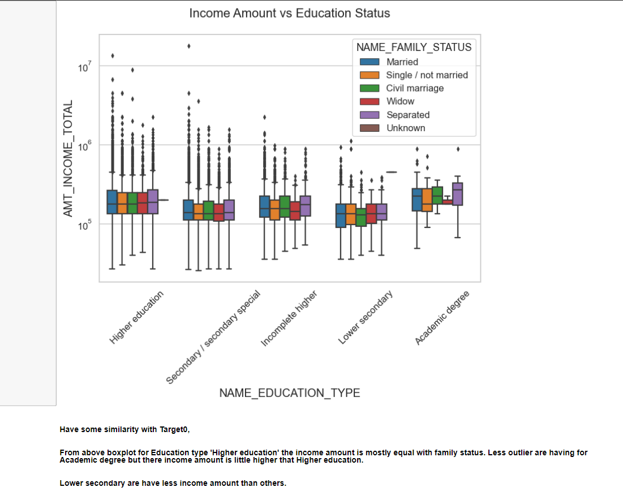

Slide 23
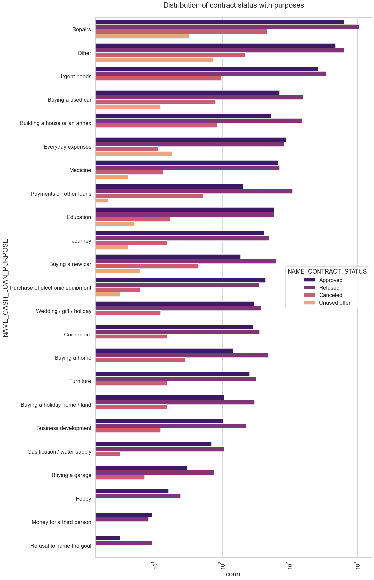
Points to be concluded from above plot:
1. Most rejection of loans came from purpose 'repairs'.
2. For education purposes we have equal number of approves and rejection
3. Payign other loans and buying a new car is having significant higher rejection than approves.

Slide 24
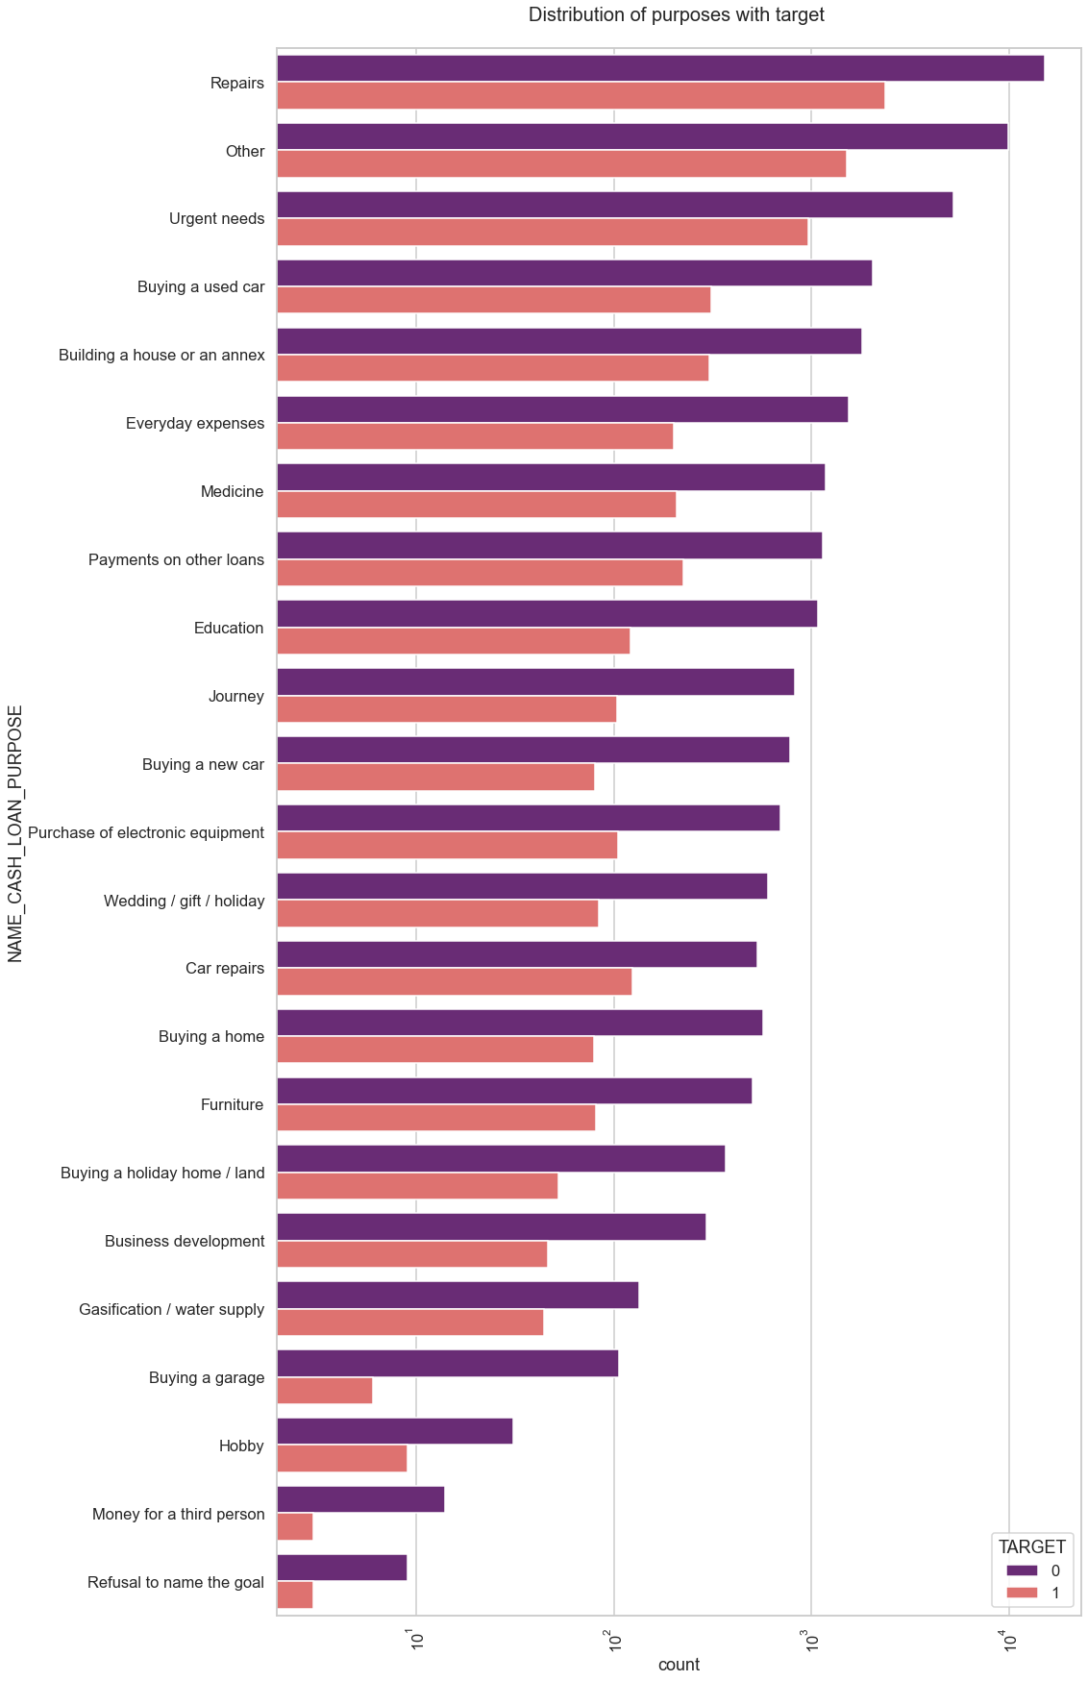
Few points we can conclude from abpve plot:
1. Loan purposes with 'Repairs' are facing more difficulites in payment on time.
2. There are few places where loan payment is significant higher than facing difficulties.
They are 'Buying a garage', 'Business developemt', 'Buying land','Buying a new car' and 'Education'
Hence we can focus on these purposes for which the client is having for minimal payment difficulties.

Slide 25
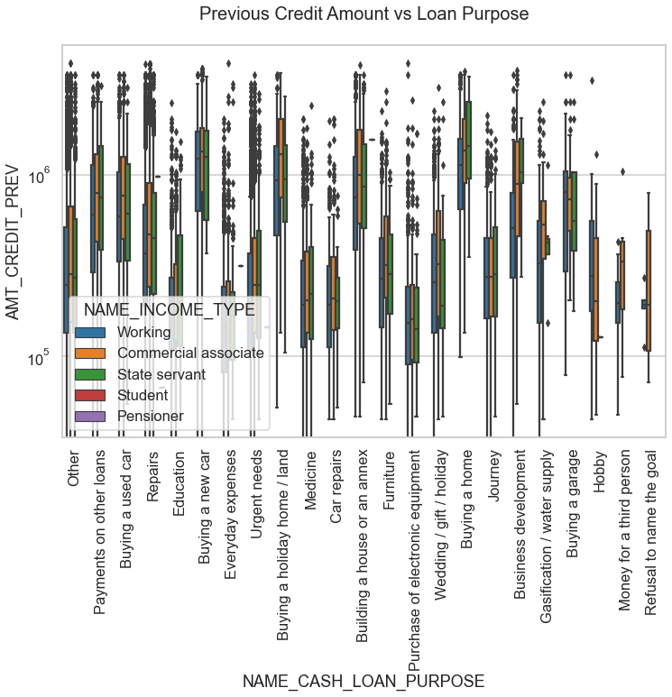
From the above we can conclude some points-
1. The credit amount of Loan purposes like 'Buying a home','Buying a land','Buying a new car' and'Building a house' is higher.
2. Income type of state servants have a significant amount of credit applied
3. Money for third person or a Hobby is having less credits applied for.

Slide 26
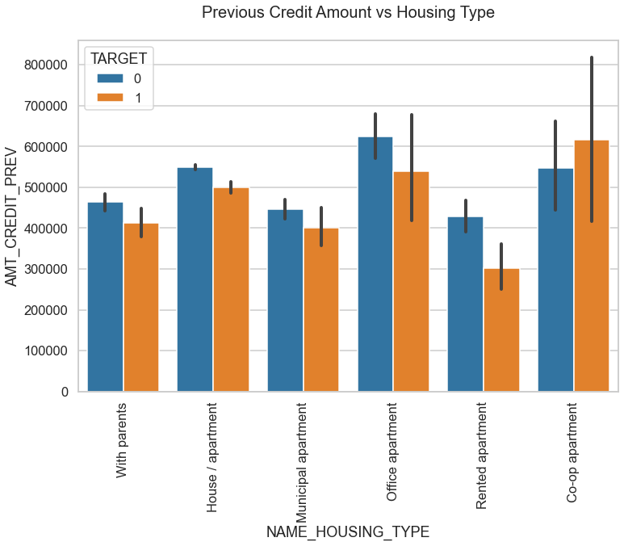
Here for Housing type, office appartment is having higher credit of target 0 and co-op apartment is having higher credit of target 1.
So, we can conclude that bank should avoid giving loans to the housing type of co-op apartment as they are having difficulties in payment.
Bank can focus mostly on housing type with parents or House\appartment or miuncipal appartment for successful payments.

Slide 27
CONCLUSION
1.Banks should focus more on contract type ‘Student’ ,’pensioner’ and ‘Businessman’ with housing ‘type other than ‘Co-op apartment’ for successful payments.
2. Banks should focus less on income type ‘Working’ as they are having most number of unsuccessful payments.
3. Also with loan purpose ‘Repair’ is having higher number of unsuccessful payments on time.
4. Get as much as clients from housing type ‘With parents’ as they are having least number of unsuccessful payments.

